Slide 1
Research in English Literature
Is it possible in
English Education Department?
A Session
of Professional Development with
NK ARIE SUWASTINI

Slide 2
Research History
Negotiations of Female Subjectivity in Jane Austen’s Films (2015)
Representations of Identity Negotiations in The Mists of Avalon (2009)
13. In/Fidelity Criticism: Toward The More Critical Adaptation Studies (Denpasar, 2014)
12. Jane Austen in Bali: My Secret Mentor in Feminism (Melbourne, 2014)
Character Revelations in Jane Austen’s Novels (2002)
11. Negotiations of Subjectivity in Made Taro’s Kisah-Kisah Tantri (Yogjakarta, 2013)
10. Willing to be Kissed: Framing Sexuality in Andrew Davies’ Sense … (Melbourne, 2011)
9. Power Relations in the Translation of Arundhati Roy’s God of Small …(Jakarta, 2011)
8. The Political Economy behind the Commercial Success of the Film … (Preston, 2011)
7. Undercover! Introducing Feminism through the Use of Film Adaptations … (Nottingham, 2011)
6. The Interplaying of Feminist Issues in the Adaptation of Jane Austen’s Novels (Singapore, 2011)
5. Bridging the Pop and the Classics: Film Adaptations as Gateway to English Literature (Surakarta, 2010)
4. Mis-framing and Anti-Framing in the 2005’s Adaptation of Jane Austen’s …. (Turkey, 2010)
3. Sense and Sexuality: Eliza William’s Case in Andrew Davies’ Sense and Sensibility (Turkey, 2010)
2. Cinematic Translation of Jane Austen’s Character Revelations … (Surabaya, 2010)
1. A Garland of Irony in Guy de Maupassant’s Diamond Necklace (Lingua Scientia, 2007)

Slide 3
UNDERGRADUATE THESES ON LITERATURE
LITERARY TEXTS
A TOUCH OF THEORY
CLOSE READING
ANALYSIS ON ONE OR ELEMENTS OF A LITERARY TEXT
COMPARISONS OF SOME ELEMENTS IN SEVERAL TEXTS
ANALYSIS ON IDEOLOGICAL/SOCIAL ASPECTS OF THE TEXTS

Slide 4
POSTGRADUATE STUDIES
Researches:
Theses,
End of Semester Essays,
Articles, Academic Presentations
GRADUATION
Approaches:
Structuralism, New Criticism, Feminism, Post-colonial, Post-Structuralism, Post-feminism, Semiotics, etc
EXPLORING NEW THEORIES
PLEASURES
ENGLISH PROFICIENCY
PERSISTENCE
FUN
PASSION
LITERARY TEXTS:
Poem(s), Short Story(ies), Novel(s), Movie(s)

Slide 5
Character Revelations in Jane Austen’s Novels (2002)
Objects of study: Jane Austen Novels (6 titles)
Focus of study: Techniques of Character Revelation
Research Background: Jane Austen’s acclaimed reputations as realistic novels with very well-developed characters.
Research Purpose: Finding the Techniques of Character Revelations in Jane Austen’s Novels
Approach: Textual, Discourse Analysis
Method: Close Reading
Steps:
Read the novels
Reads the elements of prose fiction, especially techniques of character revelation
Identify the techniques used in each novels
Conclude what techniques used most frequently and the least frequently.
Voila!

Slide 6
Cinematic Translation of Jane Austen’s Character Revelations in the 2005’s Adaptation of Pride and Prejudice
Objects of study: Jane Austen’s Pride and Prejudice and Joe Wright’s Adaptation in 2005
Focus of study: Techniques of Character Revelation in the Novels and Characterization in the Movie
Research Background: The many changes during adaptation process due to the different media and limited space in movie.
Research Purpose: Finding out how the change of medium affects the characterization of Elizabeth Bennet as the main character and how the characterization is accomplished.
Approach: Textual, Discourse Analysis
Method: Close Reading
Steps:
Read the novels
Reads the elements of prose fiction, especially techniques of character revelation
Identify the techniques used in each novels
Conclude what techniques used most frequently and the least frequently.
Voila!

Slide 7
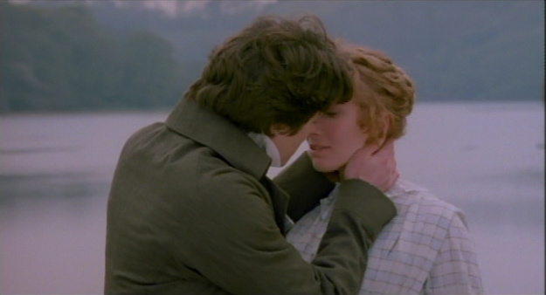
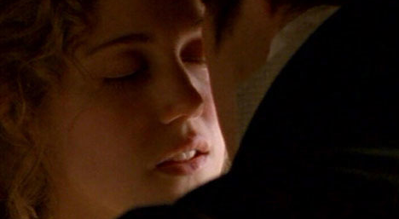
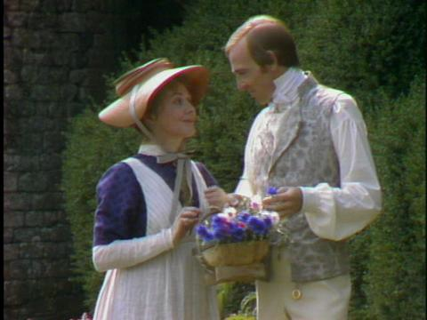
Willing to be Kissed: Framing Sexuality in Andrew Davies’ Sense and Sensibility (2008)
Objects of study: Film Adaptations of Jane Austen’s Sense and Sensibility in 1981, 1995, 2008
Focus of study: Kissing Scenes
Research Background: Jane Austen’s reluctance to STATE sexuality; the the occurrences of kissing scene in the film adaptations
Research Purpose: Finding the pattern of the occurence
Approach: Textual; film as text
Method: Close Reading
Steps:
Watch the movies
Count the kissing scenes or near-kissing scenes in each movie
Identify the frequency of the scene in each movie
Compare the occurrences: which movie has the most scene; which movie has the least
Identify if there is any pattern
Conclusion: there is a developing tendency to include kissing scene from 1981 to 1995 to 2008.

