Slide 1
Opportunities for Professional Growth
Jennifer Uhler
Regional English Language Office

Slide 2
Overview
Activity #1: What is PD?
Activity #2: Self-Assessment
Activity #3: Get Involved!

Slide 3
Activity #1:Think-Pair-Share
What does “professional development” mean?
Why should you seek professional development?

Slide 4
PD is…
a “process of continual intellectual, experiential, and attitudinal growth of teachers”
(Lange, 1990, p. 250)

Slide 5
…and PD is also…
“see[ing] the larger picture of what goes on in learning”
(Underhill, 1994, p. v)

Slide 6
…and, finally, PD is…
“a broader examination of common professional learning process and alternative conceptualizations of what was being learned through that process”
(Freeman, 2009, p. 14)

Slide 7
Why seek PD?
acquire new knowledge and skills
accept change
increase income, prestige, position
power
combat negativity and burnout
interact with colleagues
create networks
Bailey, Curtis, and Nunan (2001)

Slide 8
Activity #2: Self-Assessment
TESOL Standards Self-Assessment
1= I approach this standard
2= I meet this standard
3 = I exceed this standard

Slide 9
Standard | Your Score
Planning
2. Instructing
3. Assessing
4. Identity and Context
5. Language Proficiency
6. Learning
7. Content
8. Commitment to Professionalism
1= I approach this standard
2= I meet this standard
3 = I exceed this standard

Slide 10
TESOL Standard 1. Planning
Teachers plan instruction to promote learning and to meet learner goals, and modify plans to assure leaner engagement and achievement.

Slide 11
TESOL Standard 2. Instructing
Teachers create supportive environments that engage all learners in purposeful learning and promote respectful classroom inteactions (classroom management, instructor role, activities & strategies, learner considerations).

Slide 12
TESOL Standard 3. Assessing
Teachers gather and interpret information about learning and performance to promote the continuous intellectual and linguistic development of each learner. Teachers involve learners in determining what will be assessed.

Slide 13
TESOL Standard 4. Identity and Context
Teachers understand the importance of who learners are and how their communities, backgrounds, and goals shape learning and expectations of learning.

Slide 14
TESOL Standard 5. Language Proficiency
Teachers demonstrate proficiency in social, business/workplace, and academic English. Proficiency in speaking, listening, reading, and writing means that a teacher is functionally equivalent to a native speaker with some higher education.

Slide 15
TESOL Standard 6. Learning
Teachers draw on their language and adult language learning to understand the processes by which learners acquire a new language in and out of classroom settings.

Slide 16
TESOL Standard 7. Content
Teachers understand that language learning is most likely to occur when learners are trying to use the language for genuine communicative purposes. Teachers design their lessons to help learners acquire the language they need to successfully communicate in the subject or content areas about which they want or need to learn.

Slide 17
TESOL Standard 8. Commitment to Professionalism
Teachers continue to develop their understanding of the relationships between second language teaching and learning through the community of English language teaching professionals, the broader teaching community, and the community at large.

Slide 18
Standard | Your Score
Planning
2. Instructing
3. Assessing
4. Identity and Context
5. Language Proficiency
6. Learning
7. Content
8. Commitment to Professionalism
1= I approach this standard
2= I meet this standard
3 = I exceed this standard

Slide 19
Activity #3: Get Involved!
What are some professional opportunities in your…
school?
town?
city?
region?
- country?

Slide 20
www.tesol.org
14,000 organization members
101 affiliates; 47,000 TESOL professionals
Events, annual convention
Advocacy
Standards
Publications, resources
Career services
Notes:
What is this event? TESOL (Teaching English to Speakers of Other Languages) is a global professional organization that serves the needs of 14,000 English as a second language (ESL) and English as a foreign language (EFL) educators. TESOL also has a community of 101 worldwide affiliates that supports the educational needs of over 47,000 TESOL professionals. Its annual event attracts over 7,000 applied linguists, researchers, and practitioners from around the globe. More information about the organization can be found at www.tesol.org.

Slide 21
Values statement
professionalism in language education
individual language rights
accessible, high-quality education
collaboration in a global community
interaction of research and reflective practice for educational improvement
respect for diversity and multiculturalism

Slide 22
Colloquia
Demonstrations
Discussion Groups
Experimental Formats
Papers
Poster Sessions
Reports
Video and Digital Media Theater
Workshops

Slide 23
Contact with famous figures
Aziz Abu Sarah, Conflict Resolution
TESOL President Dr. Andy Curtis
Dr. Jeannette Altarriba, Bilingual Language Processing
Dr. Anne Curzan, English as a Lingua Franca

Slide 24
How much?
Global Membership USD $35
TESOL Quarterly +$25
2015 Annual Convention USD $320

Slide 25
Support for attendance
1. TESOL Professional Development Grants
Registration + Pre-conference Institute
2. TESOL/TEFL Travel Grant
Travel and basic expenses not to exceed U.S.$2,500
3. TESOL Award for International Participation
Travel and lodging expenses to attend and present provided by the TOEFL Board of ETS
4. RELO Support
Small grants (cost share) for presenters.

Slide 26
TEFLIN Teachers of English as a Foreign Language in Indonesia

Slide 27
Exchange Programs
FLTA: Foreign Language Teaching Assistants
Fulbright Scholar
Hubert Humphrey
SUSI: States Institutes for Scholars and Secondary Educators

Slide 28
Think about your professional network.
Who is already in your professional network? Who do you want tobe in your network? How can you expand this circle?

Slide 29
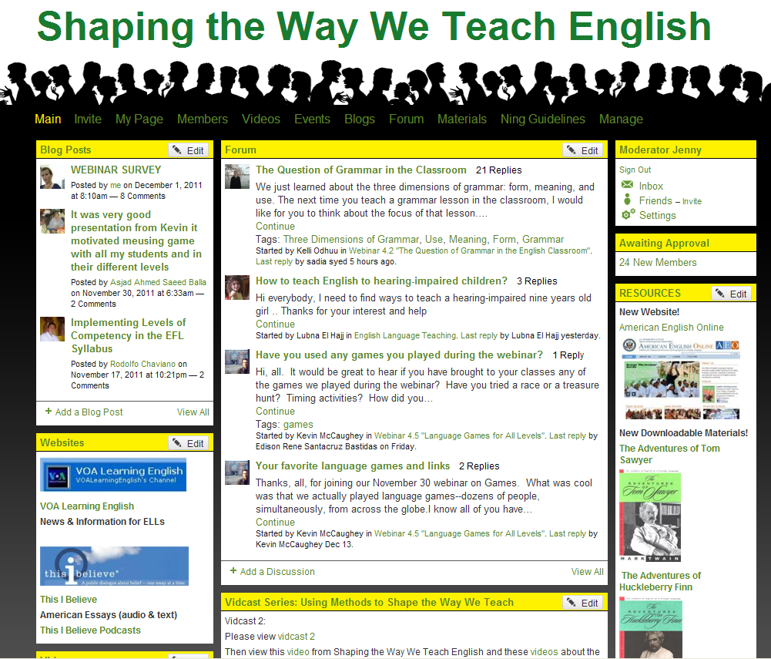
American English Webinars
Audience: English teachers worldwide
E-Certificates awarded
Social Networking (Ning) community of practice
Notes:
Each webinars is 90 minutes
Each course consists of 5 webinars
Teachers who participate in at least 3 out of 5 webinars receive an e-certificate
The Ning is a place where teachers can participate in discussions between webinars. They can also access materials and recordings of past webinars.

Slide 30
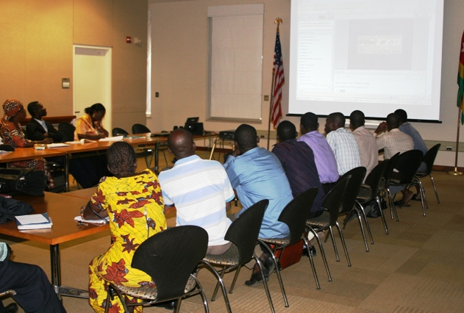
American English Webinars
Series 1
September 9 –November `8, 2015
Social Media as a Tool for Community Engagement
Podcasting in the Classroom
Co-Teaching: Strategies for Sharing and Improving the Experience
Learn It! Share It! Using a Variety of Tools for Sharing Best Practices and Tools Across Continents
Building Student Autonomy through Cooperative Class Management
Making it Meaningful: Bringing Learning to Life with Culturally Relevant Teaching
60 min.
Wednesdays, 7pm Jakarta
Viewing sessions
Certificates (4/6)
Sign up! RELOJakarta@state.gov
Notes:
The participation in the webinars has been drastically increasing.
In our most recent course, webinar series 5, we had our most attend webinar to date: with 987 teachers participating on Jan. 18th.
We encourage embassies to offer viewing sessions. This allows more teachers to participate and brings this high tech training to low tech regions.

Slide 31
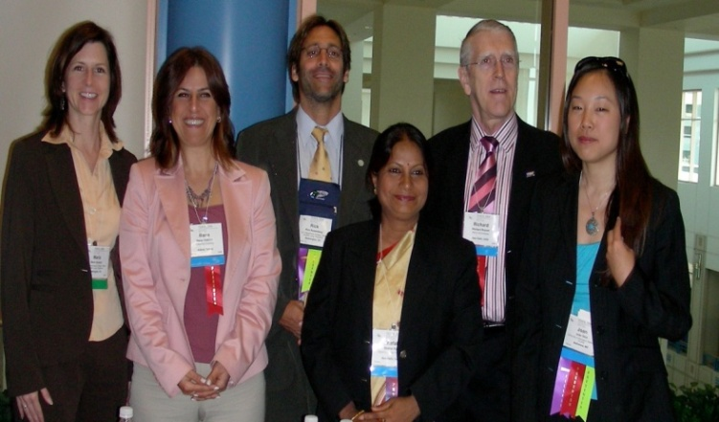
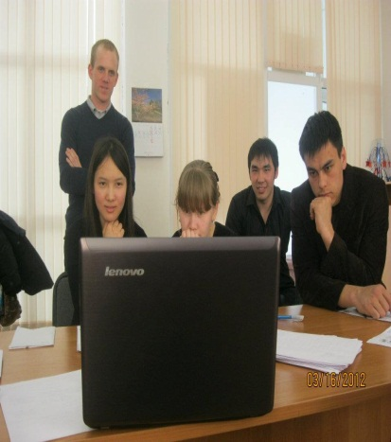
E-Teacher Scholarship Program
10-week online graduate-level courses for overseas teachers and teacher educators
Delivered by University of Oregon
9 Courses explore major areas of the Teaching English as a Foreign Language (TEFL)
To apply for a scholarship, visit our website!

Slide 32
What are some realistic ways to become professionally refreshed that cost little or no money?
(Be creative)

Slide 33
MOOCs
Massive Online Open Courses
University courses offered at no cost: All you need to participate is a good internet connection and English (usually).
Coursera www.coursera.org
Udacity www.udacity.com
EdX www.edx.org

Slide 34
Principles of Written English
(Part 1, September 14)
- UC Berkeley
Teaching Methodology (TBD)
- University of Oregon

Slide 35
FaceBook www.facebook.com/groups/teachervoices

Slide 36
www.facebook.com/IndonesiaEnglishLanguageFellows

Slide 37
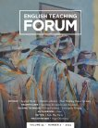
English Teaching Forum
Quarterly journal for and by English teachers around the world
International reputation for excellence
89,000 copies distributed in 130+ countries
Issues dating back to 1993 available online at forum.state.gov

Slide 38
Teaching and Learning Resources
Notes:
You will find these resources and many more at AmericanEnglish.State.gov. When you click on Resources for teachers, you will see a variety of ways to access our materials. First, you can enter a KEYWORD and search for materials that way. You can also use our search function to narrow down the resources by Audience, Pedagogical Category, Skills, Type of Content, and Theme.

Slide 39
American Culture
Resources for learning about the United States:
American culture
Links to websites about museums, the White House, and U.S. history
Content Spotlight with cultural highlights and activities
Notes:
An entire section of the website is devoted to U.S. culture. Teachers and learners can learn more about the United States, its history, geography, literature, and traditions. There are many resources here that address culture, including websites from a wide variety of U.S. government agencies that have educational web pages.

Slide 40
Content Spotlight
Highlights of American culture
Links to AE resources and materials
Classroom activities and lesson ideas
Social media connections
Notes:
This page leads into pages about Thanksgiving from our book, “Celebrate! Holidays in the USA”
By clicking on the tabs to view the publication or see more activity details, you will find our publications and resources, such as the information on next slide…

Slide 42
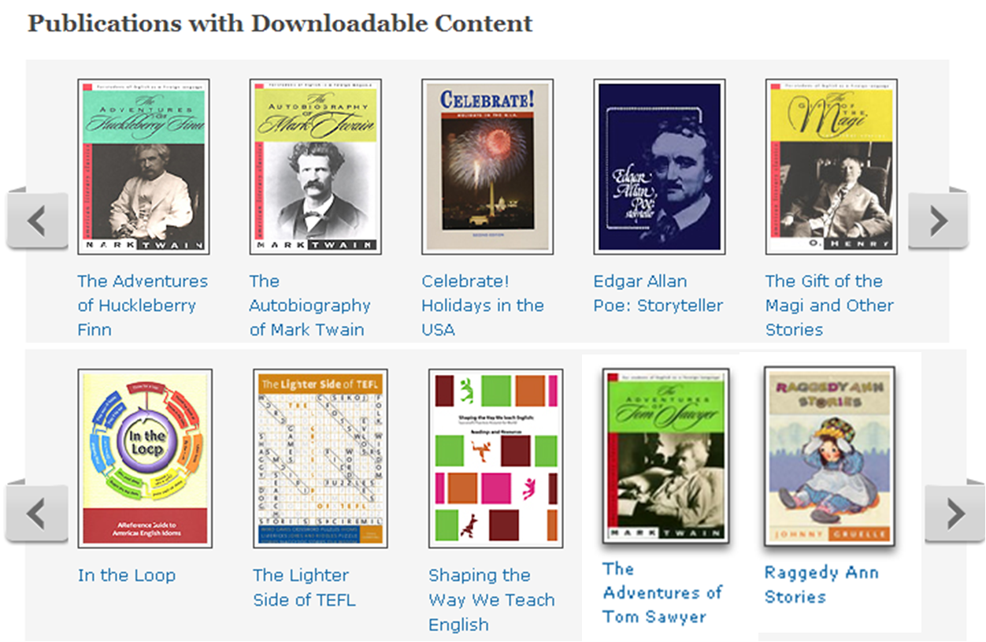
Online English Language Materials

Slide 43
Music for the English classroom
Current titles: Children’s Songs and Traditional Songs
CDs
Downloadable MP3s
Downloadable Lyrics
Downloadable Posters
American Rhythms CD and
Using Music in the Classroom teacher’s guide
New!

Slide 44
Trace Effects: Let the Adventure Begin!
Online & DVD-based computer game for Access students
3-D multimedia learning experience
Exposes players to American culture through interactive gaming
Key Themes:
Community Activism
Environmental Conservation
Empowering Women
Science and Innovation
Entrepreneurship
Mutual Understanding
Notes:
American English is also the home of Trace Effects. Trace Effects is a tool for:
Engaging younger audiences
Practicing American English
Learning about society, study, and travel in the USA
Learning while playing
A premier example of the quality offerings of the AE website is Trace Effects - a FREE video game / virtual world for English language learners
Industry experts were brought in as consultants to help ensure Trace develops into a pedagogically sound English language learning tool.
Trace Effects will complement a student’s classroom English language instruction through Web-based, interactive, 3D multimedia learning activities. This enhanced means of gaining English language skills will also provide exposure to American culture and society.
Soft launches have occurred worldwide this summer and fall in Colombia, Peru, Indonesia, Pakistan, and Jordan.

Slide 45
Any Comments or Questions?

Slide 46
Regional English Language Office Jennifer Uhler Dian Safitri Ayunda Siagian U.S. Embassy Jakarta
jakarta.usembassy.gov/relo
RELOJakarta@state.gov

